Slide 1
Computer Vision
Part 2: Feature Descriptors
ADF

Slide 2

Agenda
Part 1: Features and Detectors
Harris Corner Detector, Image Pyramid
Part 2: Feature Descriptors
HOG, Blob Detector, and SIFT
Computer Vision

Slide 3
Histogram of Oriented Gradients
Computer Vision

Slide 4
Edges
Computer Vision

Slide 5
HOG: Human Detection
Computer Vision

Slide 6
Histogram - Revisit
0 | 1 | 1 | 2 | 4
2 | 1 | 0 | 0 | 2
5 | 2 | 0 | 0 | 4
1 | 1 | 2 | 4 | 1
Computer Vision

Slide 7
Image Histogram - Revisit
Computer Vision

Slide 8
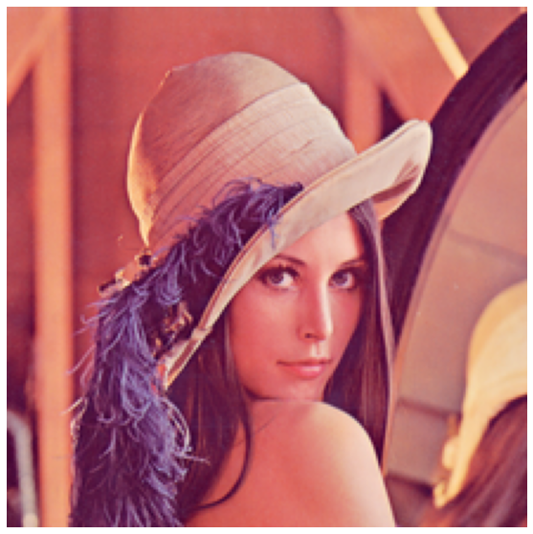
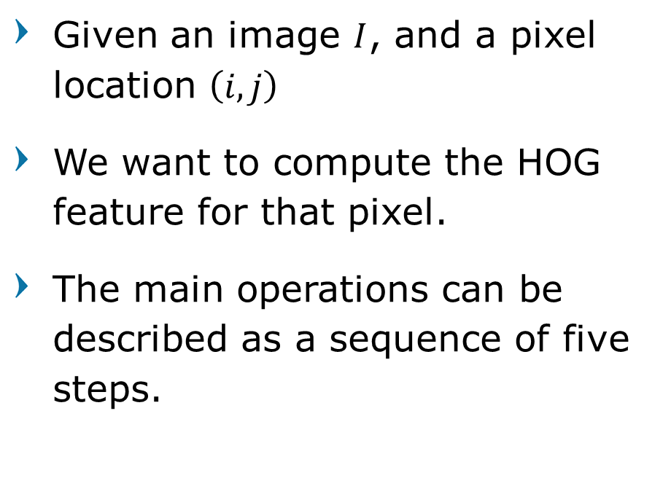
Histograms of Oriented Gradients
Given an image $I$, and a pixel location $\left(i,j\right)$
We want to compute the HOG feature for that pixel.
The main operations can be described as a sequence of five steps.
Computer Vision

Slide 9
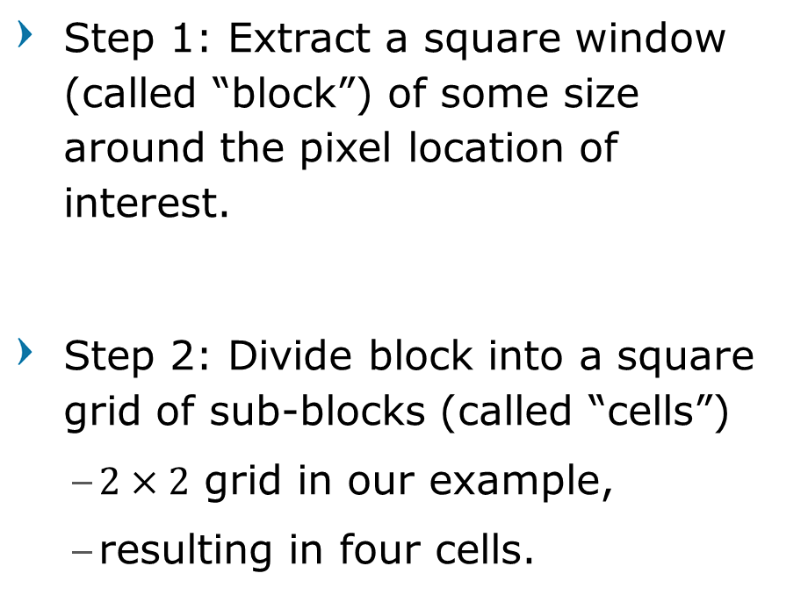
Histograms of Oriented Gradients
Step 1: Extract a square window (called “block”) of some size around the pixel location of interest.
Step 2: Divide block into a square grid of sub-blocks (called “cells”)
$2×2$ grid in our example,
resulting in four cells.
Computer Vision

Slide 10
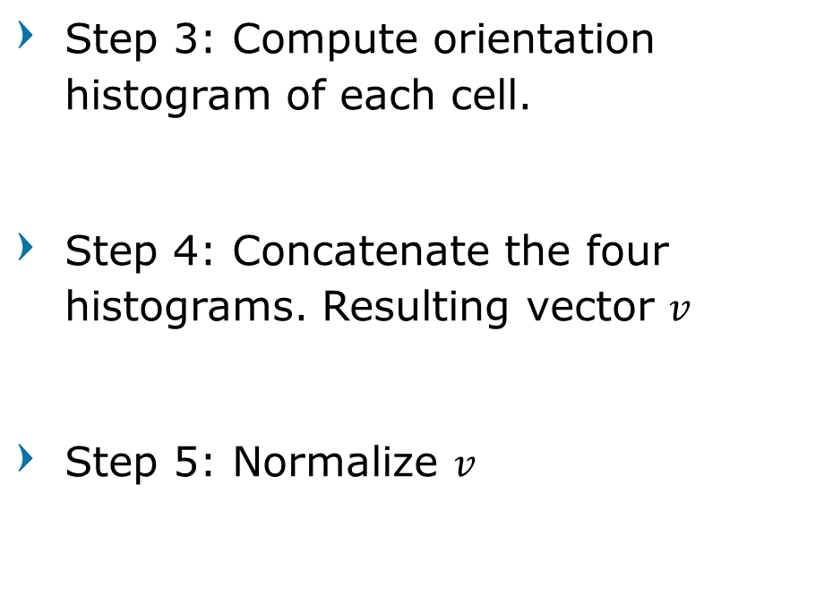
Histograms of Oriented Gradients
Step 3: Compute orientation histogram of each cell.
Step 4: Concatenate the four histograms. Resulting vector $v$
Step 5: Normalize $v$
Computer Vision

Slide 11
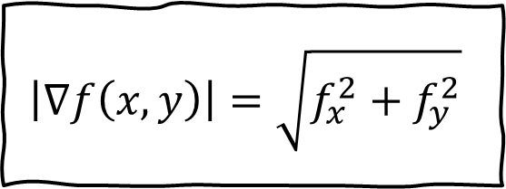
Derivative in 2D
Given function
Gradient vector
Gradient magnitude
Gradient direction
$$f\left(x,y\right)$$
$$\left|∇f\left(x,y\right)\right|=\sqrt{f_{x}^{2}+f_{y}^{2}}$$
$$∇f\left(x,y\right)=\left[\frac{∂f\left(x,y\right)}{∂x},\frac{∂f\left(x,y\right)}{∂y}\right]$$
$$=\left[f_{x}, f_{y}\right]$$
$$θ=\tan^{−1}{\frac{f_{x}}{f_{y}}}$$
Computer Vision

Slide 12
Histogram of Oriented Gradients Step-by-Step
Computer Vision

Slide 13
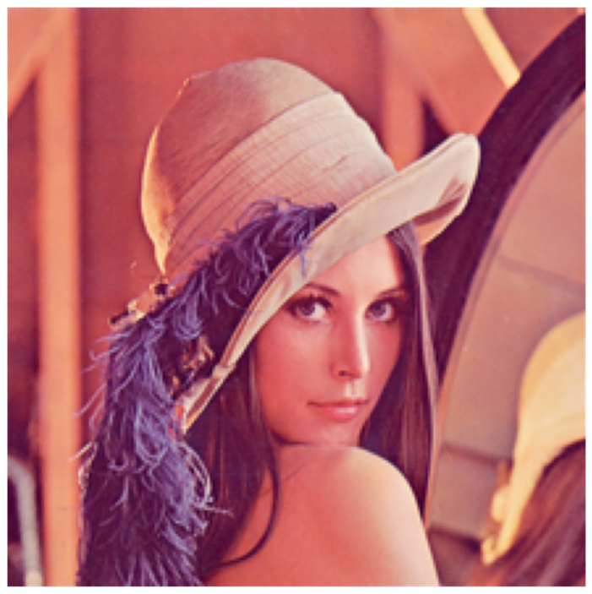
1. Derivatives
X-derivative
Magnitude
Y-derivative
Orientation
Original
Computer Vision

Slide 14
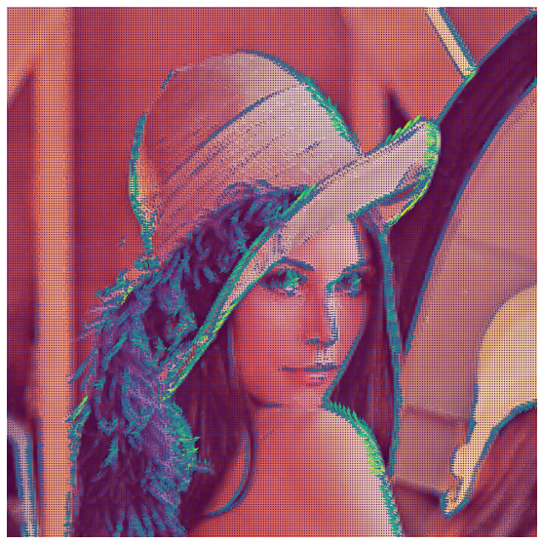
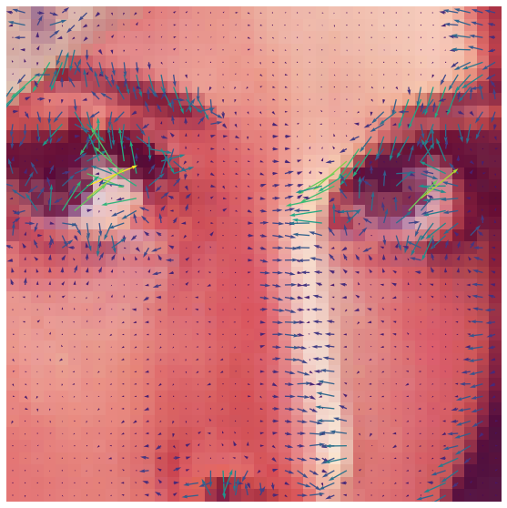
Orientation and Magnitude
Original
Computer Vision

Slide 15
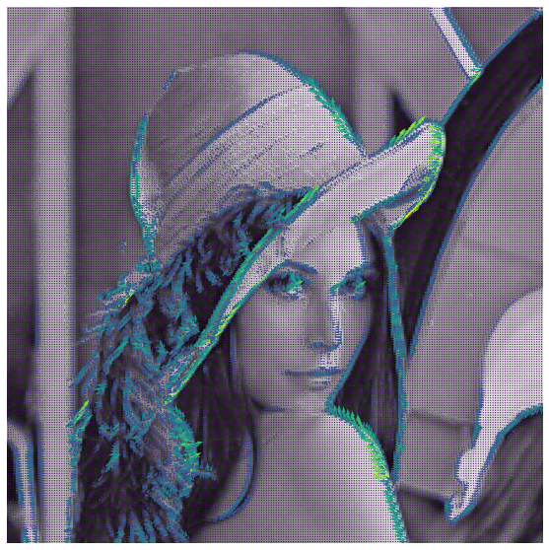
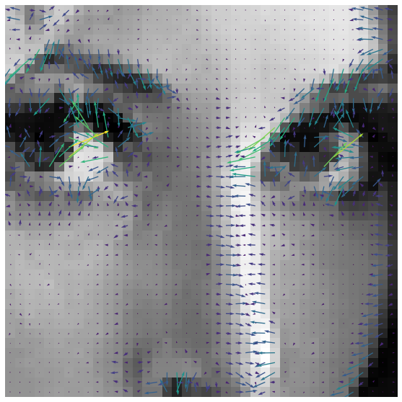
Orientation and Magnitude
Original
Computer Vision

Slide 16
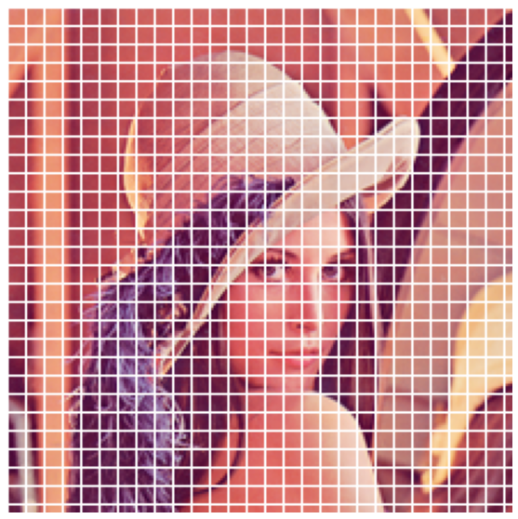
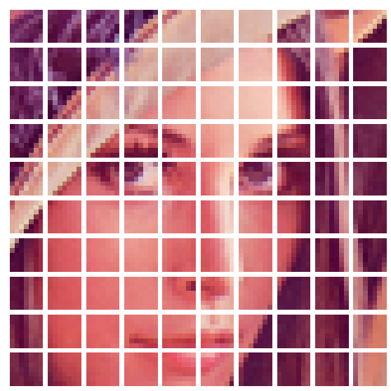
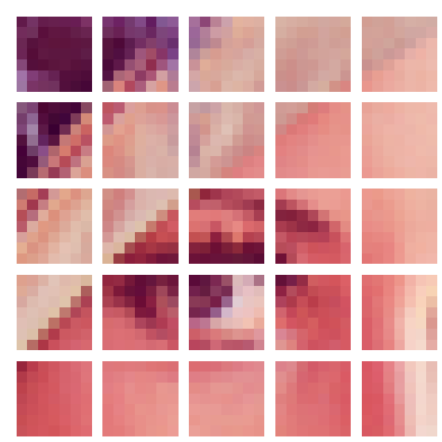
2. Divide into Cells
Computer Vision

Slide 17
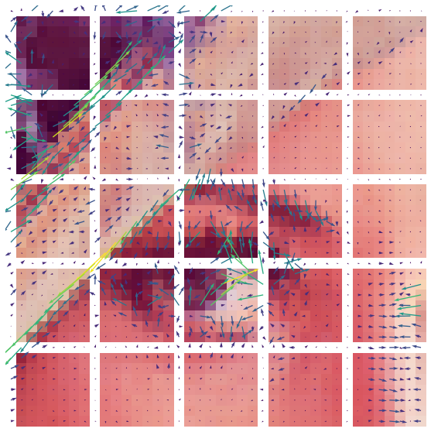
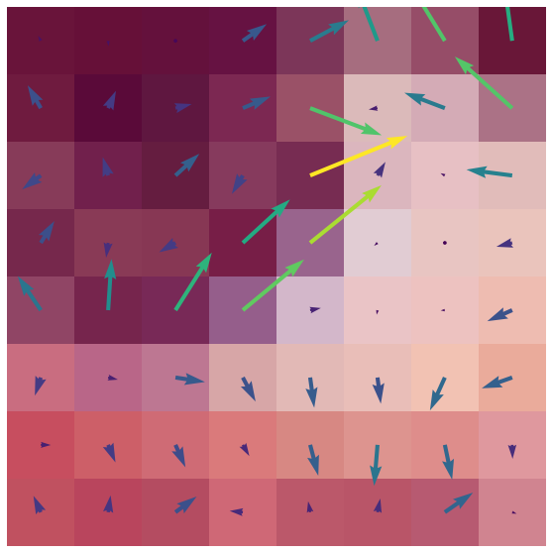
Cell Orientation and Magnitude
Magnitude
Orientation
Computer Vision

Slide 18
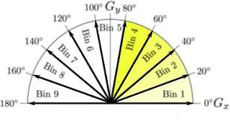
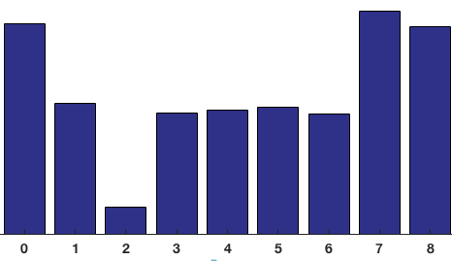
3. Bin Into Histogram
Computer Vision

Slide 19
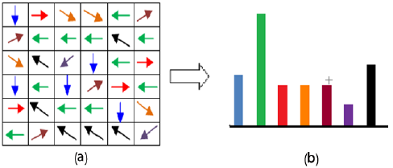
Histogram Example
Computer Vision

Slide 20
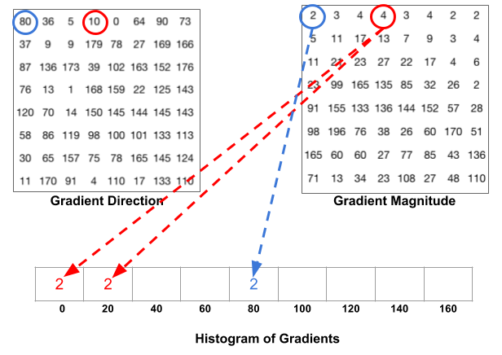
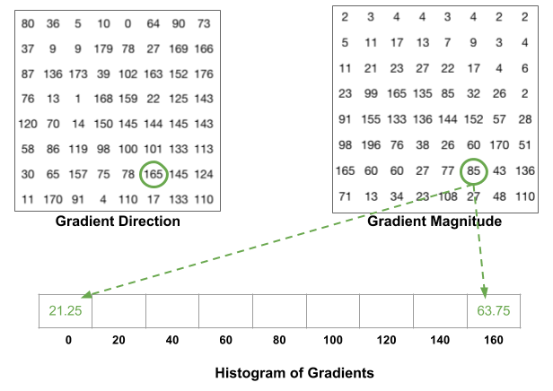
Magnitude Allocation Example
Computer Vision

Slide 21
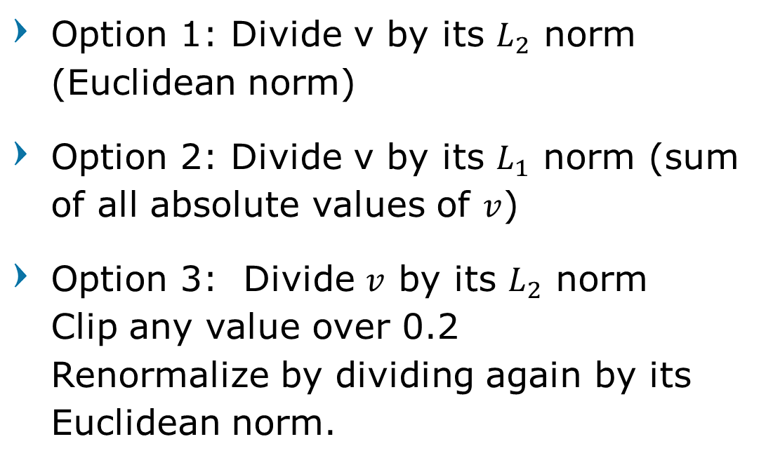
4. Normalize Blocks
Option 1: Divide v by its $L_{2}$ norm (Euclidean norm)
Option 2: Divide v by its $L_{1}$ norm (sum of all absolute values of $v$)
Option 3: Divide $v$ by its $L_{2}$ norm Clip any value over 0.2 Renormalize by dividing again by its Euclidean norm.
Computer Vision

Slide 22
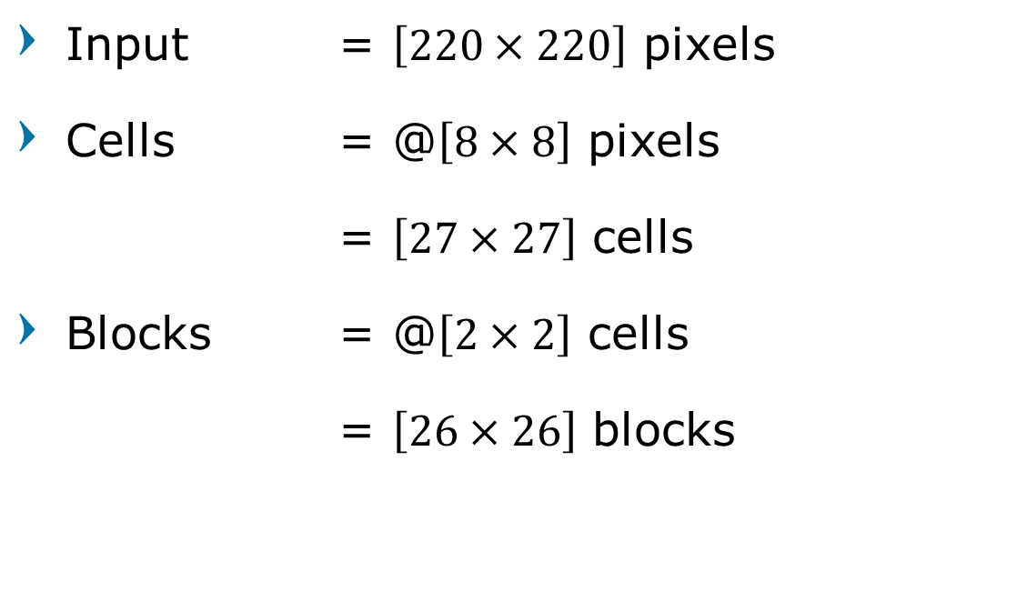
HOG Results
Input = $\left[220×220\right]$ pixels
Cells = @$\left[8×8\right]$ pixels
= $\left[27×27\right]$ cells
Blocks = @$\left[2×2\right]$ cells
= $\left[26×26\right]$ blocks
Computer Vision

Slide 23
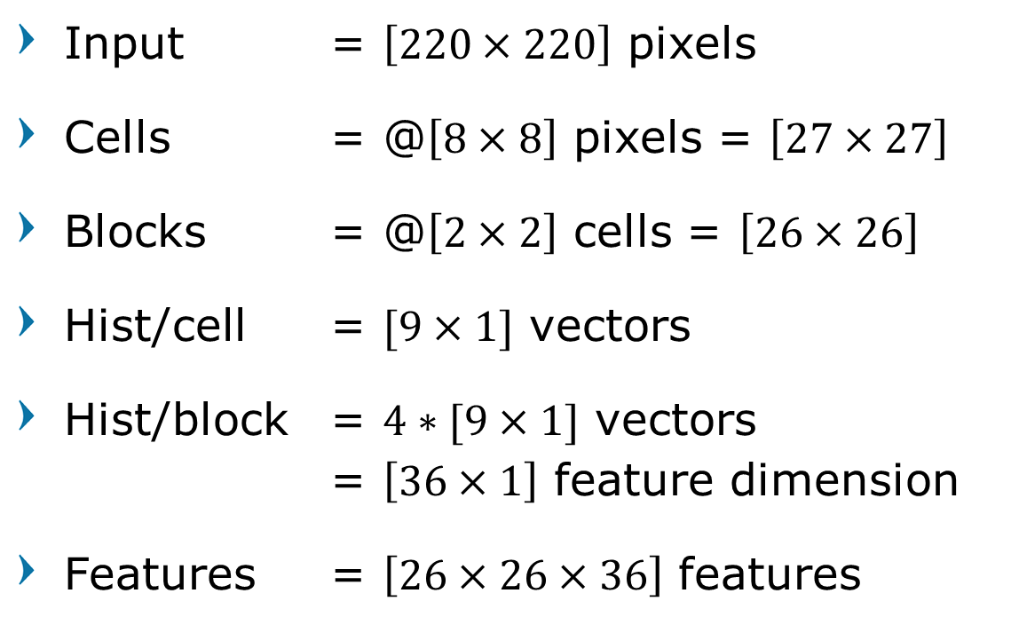
HOG Results
Input = $\left[220×220\right]$ pixels
Cells = @$\left[8×8\right]$ pixels = $\left[27×27\right]$
Blocks = @$\left[2×2\right]$ cells = $\left[26×26\right]$
Hist/cell = $[9×1]$ vectors
Hist/block = $4∗[9×1]$ vectors = $\left[36×1\right]$ feature dimension
Features = $\left[26×26×36\right]$ features
Computer Vision

Slide 24
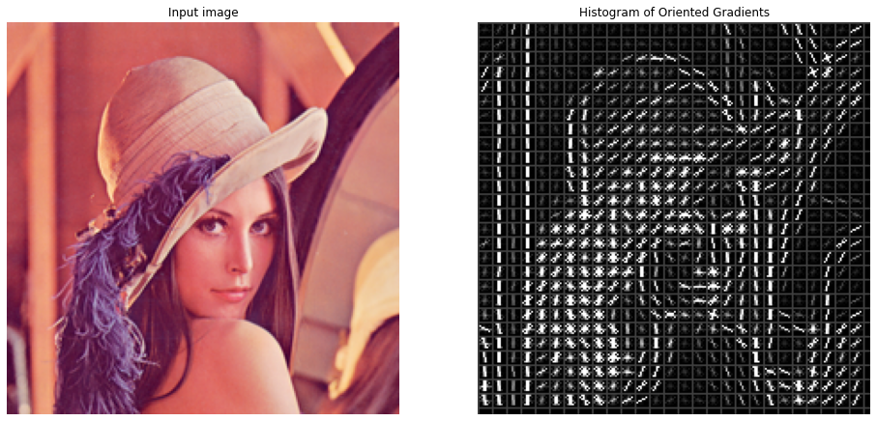
HOG Results
Computer Vision

Slide 25
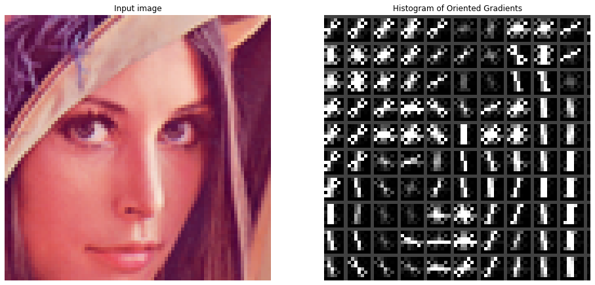
HOG Results
Computer Vision

Slide 26
Histograms of Oriented Gradients
Input
Magnitude
Orientation
Cells
Histograms
Computer Vision

Slide 27
Histograms of Oriented Gradients
Computer Vision

Slide 28
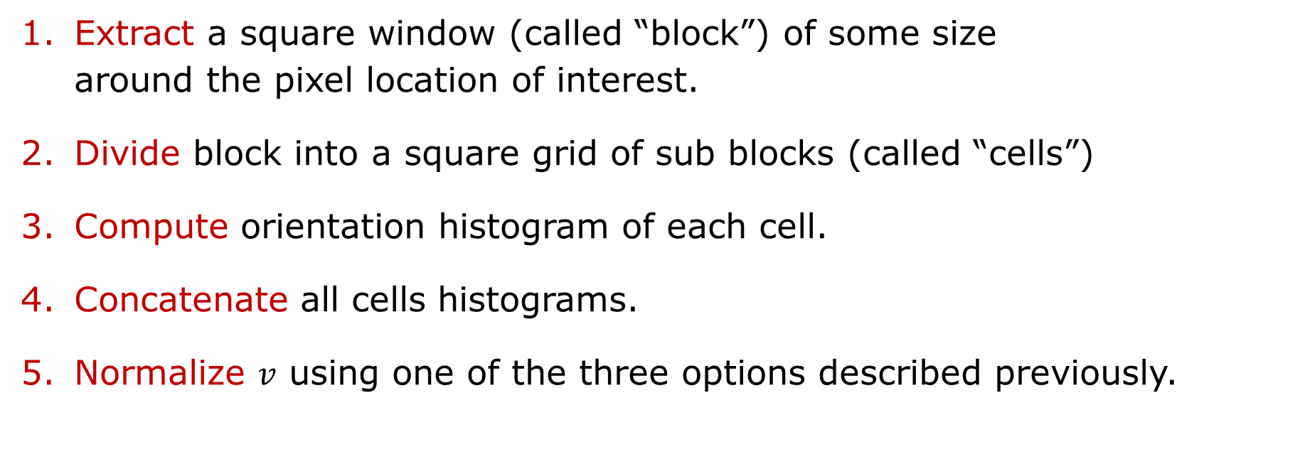
TL;DR - Histograms of Oriented Gradients
Extract a square window (called “block”) of some size around the pixel location of interest.
Divide block into a square grid of sub blocks (called “cells”)
Compute orientation histogram of each cell.
Concatenate all cells histograms.
Normalize $v$ using one of the three options described previously.
Computer Vision

Slide 29
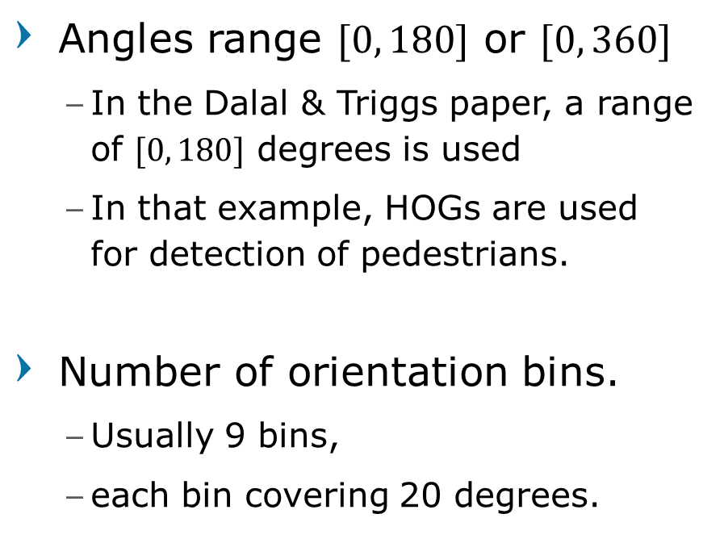
HOG Hyperparameters
Angles range $[0, 180]$ or $[0, 360]$
In the Dalal & Triggs paper, a range of $[0, 180]$ degrees is used
In that example, HOGs are used for detection of pedestrians.
Number of orientation bins.
Usually 9 bins,
each bin covering 20 degrees.
Cell size.
Cells of size 8x8 pixels are often used.
Block size.
Blocks of size 2x2 cells (16x16 pixels) are often used.
Feature Dimension
36 dimension (4 cells * 9 orientation bins.)
Computer Vision

Slide 30
Effect of cell size
10x10 cells
input
20x20 cells
Computer Vision

Slide 31
Blob Detector
Computer Vision

Slide 32
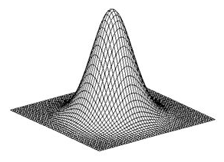
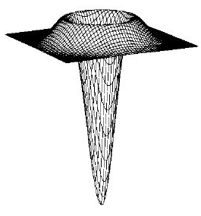
Gaussian Derivatives
Computer Vision

Slide 33
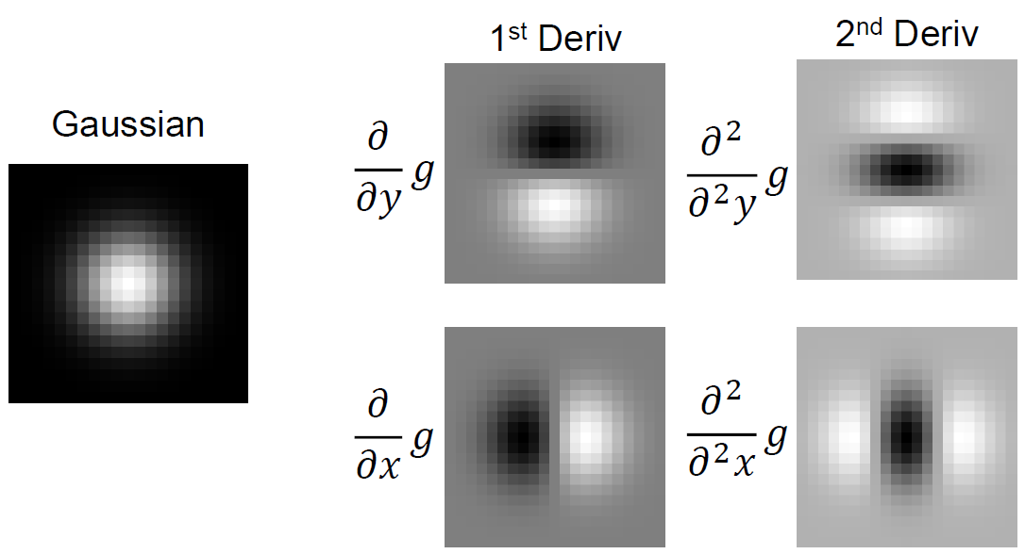
Gaussian Derivatives
Computer Vision

Slide 34
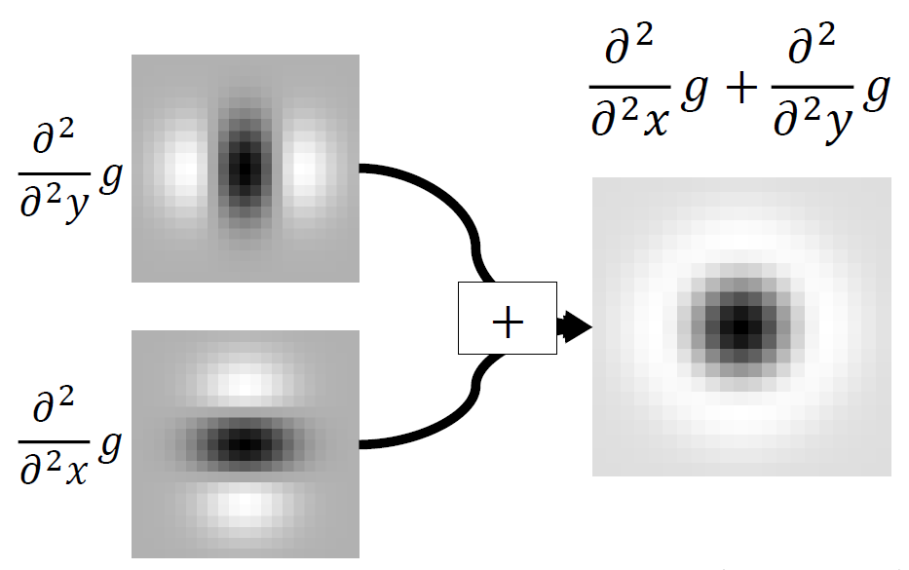
Laplacian of Gaussian
Computer Vision

Slide 35
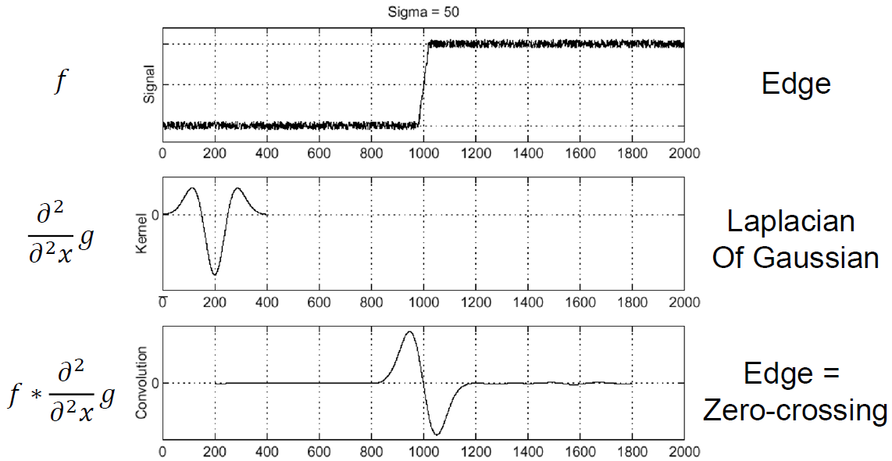
Recall: Edge Detection with Laplacian
Computer Vision

Slide 36
Blob Detection with Laplacian
Edge: zero-crossing
Blob: superposition of zero-crossing
Remember: we can scale signal or filter
Maxima
Computer Vision

Slide 37
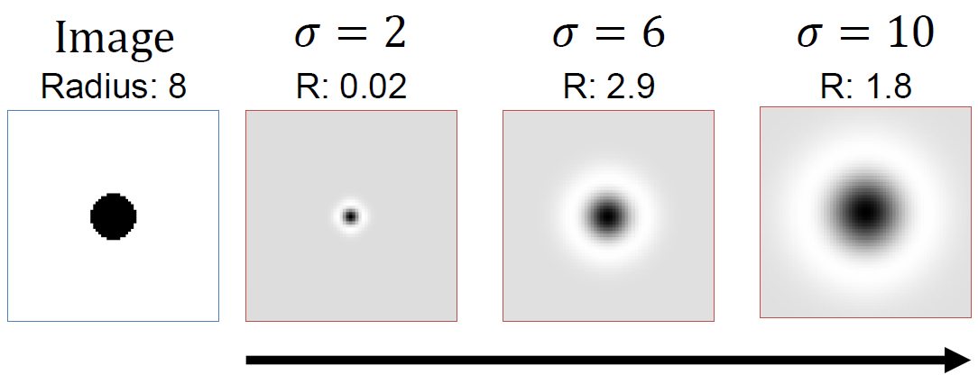

Scale Selection
Given binary circle and Laplacian filter of scale $σ$, we can compute the response as a function of the scale.
Computer Vision

Slide 38
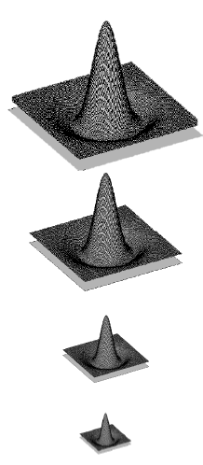
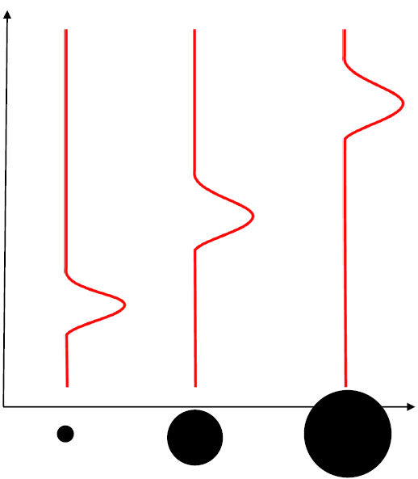
Scale Selection
“Blob” detector is common for corners
Computer Vision

Slide 39
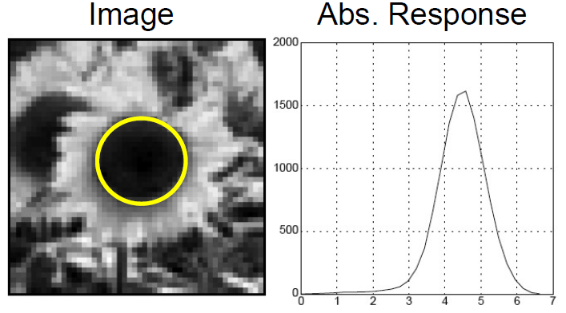
Characteristic Scale
Characteristic scale of a blob is the scale that produces the maximum response
Computer Vision

Slide 40


Blob Detection
Another detector (has some nice properties)
Find maxima and minima of blob filter response in scale and space
Minima
$$∗$$
$$=$$
Maxima
Computer Vision

Slide 41
Scale-space Blob Detector
Convolve image with scale normalized Laplacian at several scales
Find maxima of squared Laplacian response in scale space
Computer Vision

Slide 42
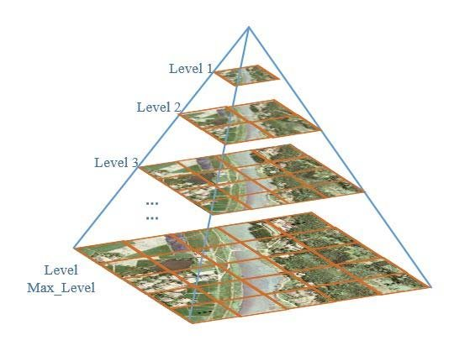
Scale-space Blob Detector: Example
Computer Vision

Slide 43
Scale-space Blob Detector: Example
Computer Vision

Slide 44
Scale-space Blob Detector: Example
Computer Vision

Slide 45
Scale-space Blob Detector: Example
Computer Vision

Slide 46
Goals for KeyPoints
Extract distinctive invariant features
Correctly matched against a large database of features from many images
Invariance / Robustness to
Affine (rotation, scale, shear) distortion
Change in 3D viewpoint
Addition of noise
Change in illumination
Computer Vision

Slide 47
Scale Invariant Feature Transform (SIFT)
Computer Vision

Slide 48
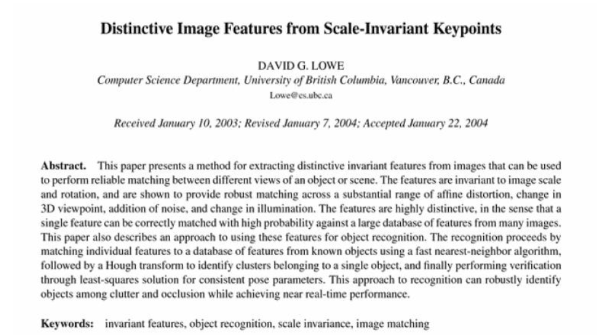
Scale Invariant Feature Transform (SIFT)
David Lowe
Computer Vision

Slide 49
Advantages
Locality
Image content is transformed into local feature coordinates
Robust to occlusion and clutter
Distinctive
can be matched to a large database of object
Feature Quantity
Many features can be generated for even small objects
Computer Vision

Slide 50
Scale Invariant Feature Transform (SIFT)
Invariant to
Translation, rotation, scale,
and other imaging parameters
Efficient
Close to real-time performance
Patented by University of British Columbia
Computer Vision

Slide 51
Scale Invariant Feature Transform (SIFT)
Image content is transformed into local feature coordinates
Computer Vision

Slide 52
SIFT Main Procedures
1 | Scale Space Extrema (Peak) Detection | Search over multiple scales and image locations
2 | Key Point Localization | Fit a model to determine location and scale. Select Key points based on a measure of stability
3 | Orientation Assignment | Compute best orientation(s) for each key point region
4 | Key Point Description | Use local image gradients at selected scale and rotation to describe each key point region. SIFT Descriptor
Computer Vision

Slide 53

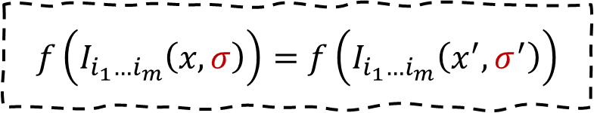
Scale Selection
How to find patch sizes at which $f$ response is equal? What is a good $f$ ?
x
x
$$f\left(I_{i_{1}…i_{m}}\left(x,σ\right)\right)=f\left(I_{i_{1}…i_{m}}\left(x^{′},σ^{′}\right)\right)$$
Computer Vision

Slide 54
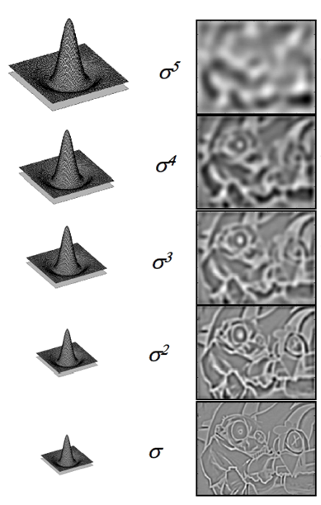
Local Maxima in position-scale space
Find maxima/minima
Computer Vision

Slide 55
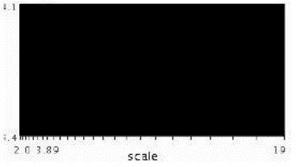
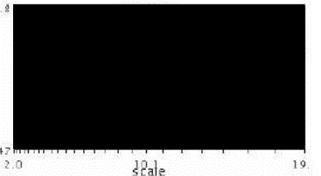
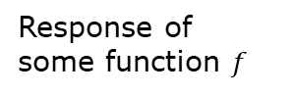
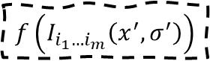
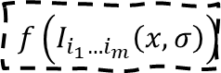
Automatic Scale Selection
X
X
Function responses for increasing scale (scale signature)
Response of some function $f$
$$f\left(I_{i_{1}…i_{m}}\left(x,σ\right)\right)$$
$$f\left(I_{i_{1}…i_{m}}\left(x^{′},σ^{′}\right)\right)$$
Computer Vision

Slide 56
Automatic Scale Selection
X
X
Function responses for increasing scale (scale signature)
Response of some function $f$
$$f\left(I_{i_{1}…i_{m}}\left(x,σ\right)\right)$$
$$f\left(I_{i_{1}…i_{m}}\left(x^{′},σ^{′}\right)\right)$$
Computer Vision

Slide 57
Automatic Scale Selection
X
X
Function responses for increasing scale (scale signature)
Response of some function $f$
$$f\left(I_{i_{1}…i_{m}}\left(x,σ\right)\right)$$
$$f\left(I_{i_{1}…i_{m}}\left(x^{′},σ^{′}\right)\right)$$
Computer Vision

Slide 58
Automatic Scale Selection
X
X
Function responses for increasing scale (scale signature)
Response of some function $f$
$$f\left(I_{i_{1}…i_{m}}\left(x,σ\right)\right)$$
$$f\left(I_{i_{1}…i_{m}}\left(x^{′},σ^{′}\right)\right)$$
Computer Vision

Slide 59
Automatic Scale Selection
X
X
Function responses for increasing scale (scale signature)
Response of some function $f$
$$f\left(I_{i_{1}…i_{m}}\left(x,σ\right)\right)$$
$$f\left(I_{i_{1}…i_{m}}\left(x^{′},σ^{′}\right)\right)$$
Computer Vision

Slide 60
Automatic Scale Selection
X
X
Function responses for increasing scale (scale signature)
Response of some function $f$
$$f\left(I_{i_{1}…i_{m}}\left(x,σ\right)\right)$$
$$f\left(I_{i_{1}…i_{m}}\left(x^{′},σ^{′}\right)\right)$$
Computer Vision

Slide 61
Alternative kernel
Approximate LoG with Difference of Gaussian (DoG)
Laplacian Pyramid
More efficient
Computer Vision

Slide 62


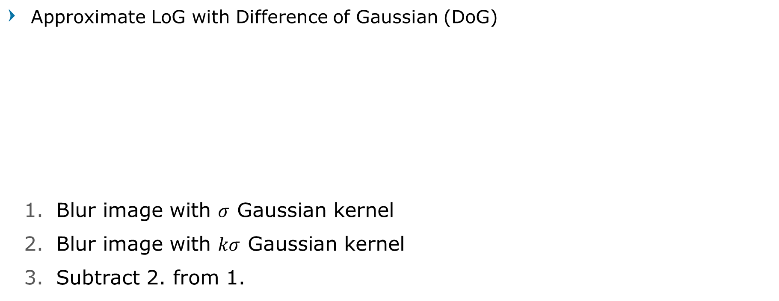
Alternative kernel
Approximate LoG with Difference of Gaussian (DoG)
Blur image with $σ$ Gaussian kernel
Blur image with $kσ$ Gaussian kernel
Subtract 2. from 1.
$$−$$
$$=$$
Computer Vision

Slide 63
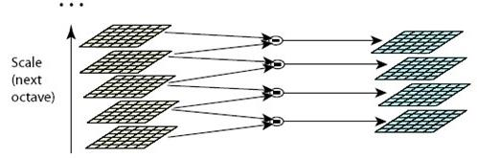
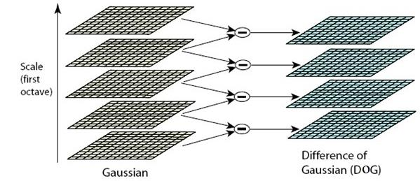
Scale-space
Computer Vision

Slide 64
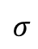
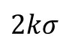




Find Local Maxima
.
.
.
Typical values
$σ=1.6$
$k=\sqrt{2}$
$$2kσ$$
$$kσ$$
-
=
$$σ$$
-
$$kσ$$
=
-
=
$$σ$$
Computer Vision

Slide 65
Results: Difference of Gaussian
Larger circles = larger scale
Descriptors with maximal scale response
Computer Vision

Slide 66
SIFT Main Procedures
1 | Scale Space Extrema (Peak) Detection | Search over multiple scales and image locations
2 | Key Point Localization | Fit a model to determine location and scale. Select Key points based on a measure of stability
3 | Orientation Assignment | Compute best orientation(s) for each key point region
4 | Key Point Description | Use local image gradients at selected scale and rotation to describe each key point region. SIFT Descriptor
Computer Vision

Slide 67



Key Point Localization
Outlier rejection using Taylor Series Expansion
Further Outlier Rejection using Hessian of D
Computer Vision
Notes:
Discarding low-contrast keypoints
Eliminating edge responses

Slide 68
SIFT Main Procedures
1 | Scale Space Extrema (Peak) Detection | Search over multiple scales and image locations
2 | Key Point Localization | Fit a model to determine location and scale. Select Key points based on a measure of stability
3 | Orientation Assignment | Compute best orientation(s) for each key point region
4 | Key Point Description | Use local image gradients at selected scale and rotation to describe each key point region. SIFT Descriptor
Computer Vision

Slide 69




Normalization
Rescale to fixed size
Computer Vision

Slide 70




SIFT Orientation Estimation
Compute gradient orientation histogram
Select dominant orientation $θ$
Computer Vision

Slide 71


SIFT Orientation Normalization
Compute gradient orientation histogram
Select dominant orientation $θ$
Normalize: rotate to fixed orientation
Computer Vision

Slide 72
SIFT Main Procedures
1 | Scale Space Extrema (Peak) Detection | Search over multiple scales and image locations
2 | Key Point Localization | Fit a model to determine location and scale. Select Key points based on a measure of stability
3 | Orientation Assignment | Compute best orientation(s) for each key point region
4 | Key Point Description | Use local image gradients at selected scale and rotation to describe each key point region. SIFT Descriptor
Computer Vision

Slide 73

SIFT Descriptor Formation
Compute on local $16×16$ window around detection.
Rotate and scale window according to discovered orientation $θ$ and scale $σ$ (gain invariance)
Computer Vision

Slide 74

SIFT Descriptor Formation
Compute on local $16×16$ window around detection.
Rotate and scale window
Compute gradients weighted by a Gaussian of variance half the window (for smooth falloff).
Actually 16x16, only showing 8x8
Computer Vision

Slide 75


SIFT Descriptor Formation
$4×4$ array of gradient orientation histograms weighted by gradient magnitude.
Bin into $8$ orientations * $4×4$ array = $128$ dimensions.
Actually 4x4, only showing 2x2
Computer Vision

Slide 76


SIFT Descriptor Extraction
8 | 8 | 8 | … | 8
Computer Vision

Slide 77

SIFT Descriptor Extraction
Computer Vision

Slide 78

SIFT Descriptor Extraction
Gradient magnitude and orientation
8 bin ‘histogram’
add magnitude
amounts!
Computer Vision

Slide 79

SIFT Descriptor Extraction
Computer Vision

Slide 80
Reduce Effect of Illumination
128 dim vector normalized to 1
Threshold gradient magnitudes to avoid excessive influence of high gradients
After normalization, clamp gradients > 0.2
Renormalize
Computer Vision

Slide 81
Review: Local Descriptors
Most features can be thought of as
templates, histograms (counts),
or combinations
The ideal descriptor should be
Robust and Distinctive
Compact and Efficient
Most available descriptors focus on edge/gradient information
Capture texture information
Color rarely used
Computer Vision

Slide 82
Properties of SIFT
Can handle up to ~60 degree out of plane rotation,
Changes of illumination
Fast and efficient and lots of code available
Computer Vision

Slide 83

Question?
Computer Vision

Slide 84

Next Agenda
Learnable Feature
CNN Architectures
Computer Vision

Slide 85
References
Yogesh Singh Rawat – CAP5415 Lectures, University of Central Florida
David Fouhey – EECS442 Lectures, University of Michigan
Grauman, K. and Leibe, B. 2011. Visual Object Recognition. Synthesis Lectures Artif. Intell. Mach. Learn. 5, 1 181
Computer Vision

